Slide 1

Experience a Safer, Stress-Free Journey with Revolutionary Driving Monitoring Systems
הייתי משתמש בסיסמא הזאת להתחלה
HeartRay
PROPRIETARY & CONFIDENTIAL

Slide 2
Our Vision
HeartRay redefines the driving experience, through cutting-edge technology seamlessly integrating automotive safety, comfort, and health with precise, contact-free physiological measurements
HeartRay
PROPRIETARY & CONFIDENTIAL

Slide 3
HeartRay Value Proposition
Cutting-edge technology delivering precise medical grade physiological measurements
Diverse Physiological Data: HeartRay collects a variety of essential measurements, enabling a comprehensive understanding of the individual's condition
Software solution, seamless integration with any DMS :Compatible with both RGB/IR cameras
HeartRay
PROPRIETARY & CONFIDENTIAL

Slide 4

Actionable insights
Fatigue detection
Stress level monitoring
Thermal comfort optimization
Cognitive Stress
Motion sickness detection and mitigation
Key Health Indicator tracking
Arrythmia
Tachy/Brady cardia
PROPRIETARY & CONFIDENTIAL

Slide 5



Go-to-Market
PROPRIETARY & CONFIDENTIAL
OEMs & Tier-1
After Market
Off- highway
Enabling seamless integration
Driver-personalization solution
Fleet management
Driver stress escalates accident
Fleet management
Aviation, Trains, Scooters
Accurately measures driver stress and well-being
Optimize infotainment and temperature environment
Alerts fleet managers of unexpected incidents: stress anomalies, abnormal heart rates
Alerts fleet managers
Off-highway vehicle errors are costlier and deadlier.
Add on to helmets
PROPRIETARY & CONFIDENTIAL
PROPRIETARY & CONFIDENTIAL
PROPRIETARY & CONFIDENTIAL
HeartRay
PROPRIETARY & CONFIDENTIAL

Slide 6
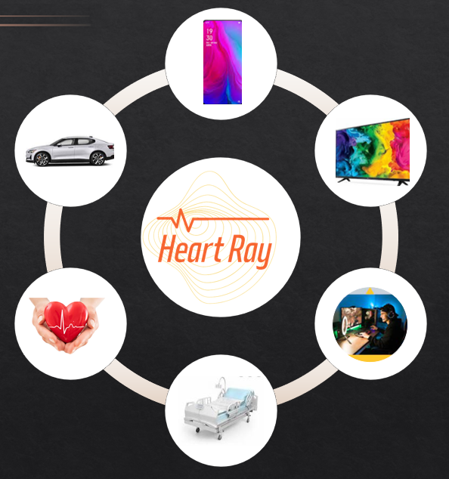

Potential markets
HeartRay
PROPRIETARY & CONFIDENTIAL

Slide 7
Go-to-Market
PROPRIETARY & CONFIDENTIAL
OEMs & Tier-1
After Market
Off- highway
PROPRIETARY & CONFIDENTIAL
HeartRay
PROPRIETARY & CONFIDENTIAL

Slide 8
Go-to-Market
PROPRIETARY & CONFIDENTIAL
safety
comfort
Health
Fatigue
stress
Thermal stress
Cognitive stress
Key health indicators
Arrythmia
Tachy / Brady cardia
PROPRIETARY & CONFIDENTIAL
HeartRay
PROPRIETARY & CONFIDENTIAL

Slide 9






Go-to-Market
PROPRIETARY & CONFIDENTIAL
Heart Rate
Respiration
HRV / IBI
Blood Perfusion
Facial
PROPRIETARY & CONFIDENTIAL
HeartRay
PROPRIETARY & CONFIDENTIAL

Slide 10
Cutting edge
Technology
Precise medical grade
measurements
Seamless integration
with any Driver monitoring system (DMS)
Software
solution
Various
Physiological Data
enabling an understanding
of the individual's condition

Slide 11
Seamless integration with any Driver monitoring system (DMS)
Precise medical grade measurements
Enabling an understanding of the individual's condition

Slide 12


